Slide 1
FeedmeWell
Qinyue Yin
Griffth Neumark
Kirill Novik
Lukasz Stankiewicz

Slide 3
Vision
A mobile phone app that can order you food with your nutrition plan in mind.

Slide 4
Methods and Tool
Purpose | Logo | Name | Rating
Project Tracker |  | Pivotal | 5/5
VCS |  | Github | 4/5
Database |  | mengo DB | 4/5
Testing |  | qUnit | 4/5
Auto documenter | JSDoc | JSDoc | 2/5
Deployment environment |  | NodeJS | 5/5
IDEs |  | Cloud9, | 4/5
IDEs |  | sublime; | 3/5

Slide 5
Challenges
Delivery.com
Authorization
Schema for Users
Phone Gap

Slide 6
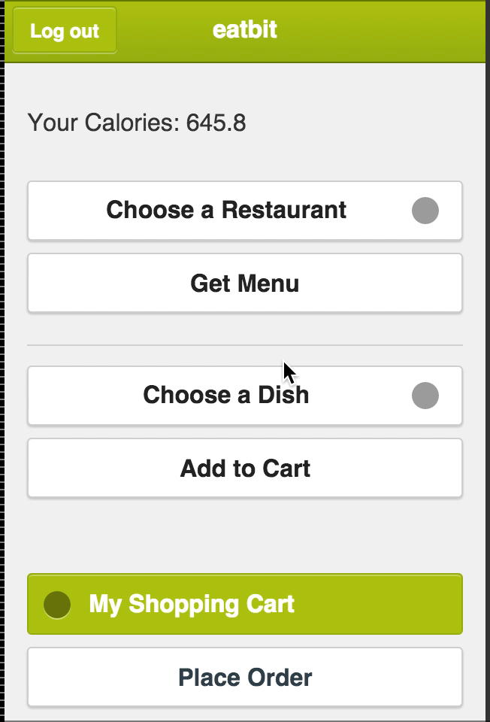
Demo 1: Interface

Slide 7
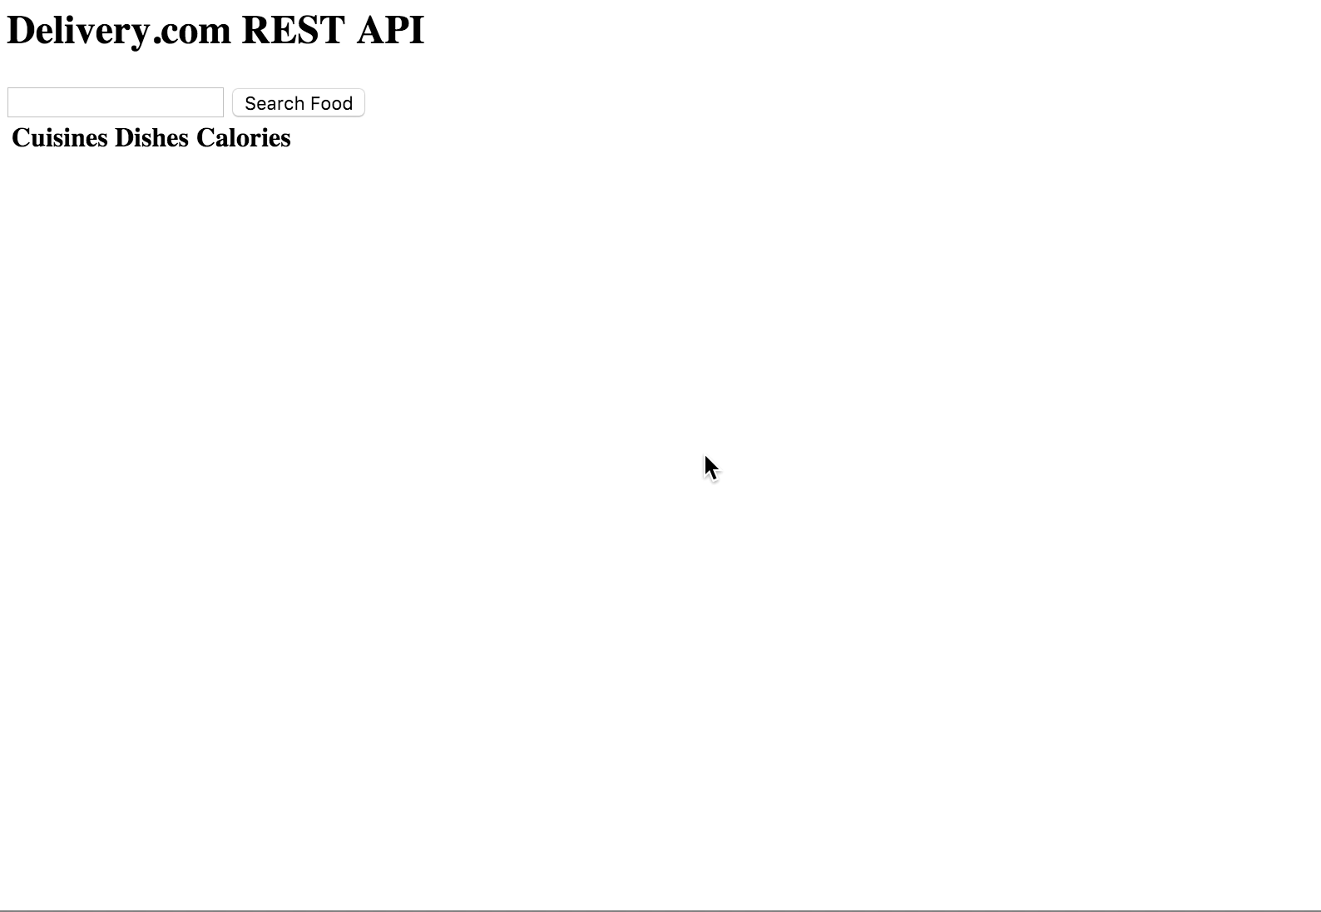
Demo 2: Calorie Data API call

